Slide 1
Poisoning attack on unlabeled data for Semi-Supervised learning
Hoang Ha, Robert Kasumba, Fiona Xu
(original paper by Nicholas Carlini)

Slide 2
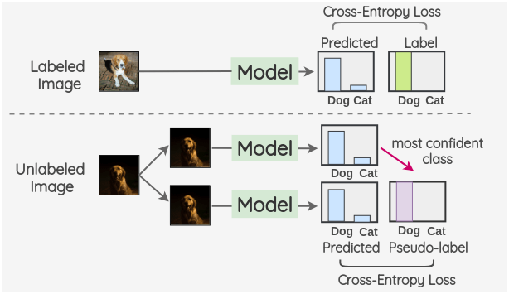
Introduction
Semi-supervised ML
Labeled Data + Unlabeled Data
Goal: Reproduce the “Interpolated Consistency Poisoning Attack”
Applying interpolated consistency attack on the unlabeled dataset of: CIFAR10, MNIST, and Fashion MNIST.

Slide 3
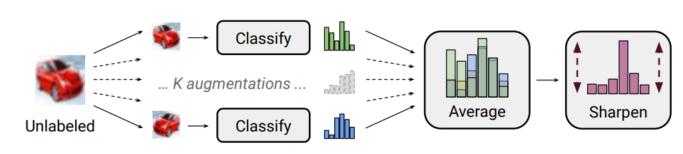
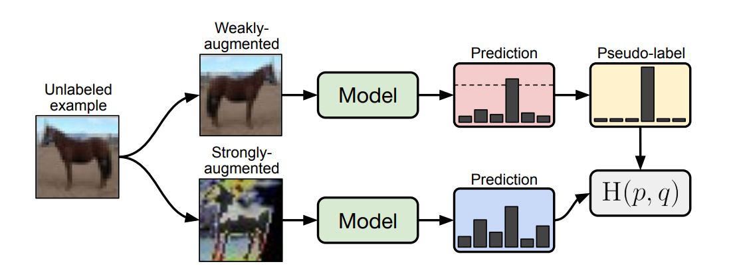
Model - FixMatch, MixMatch, Pseudo Labeling
MixMatch
FixMatch

Slide 4
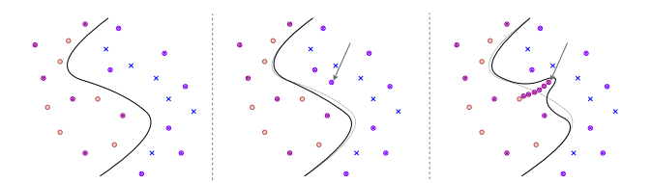
Model - Interpolated consistency poisoning
General Idea
To poison the unlabeled data we try to construct a “path” of images between an unlabeled target sample x* and a labeled source sample x’.
The goal is to make the model predict x* with the label of x’.
No poison
1 poison sample injected
N poison samples injected

Slide 5


Model - Interpolated consistency poisoning
Interpolation Strategy
α is chosen by sampling from the density function (normalized from 0 to 1)

Slide 6
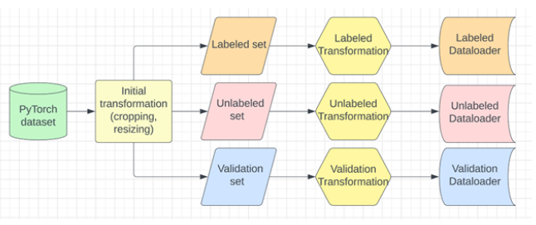
Implementation - Data Pipeline
Datasets used: CIFAR10, MNIST, and FashionMNIST.
A subset of each dataset was used with the ratio of classes preserved.
Data pipeline works for both gray-scale and RGB images.

Slide 7
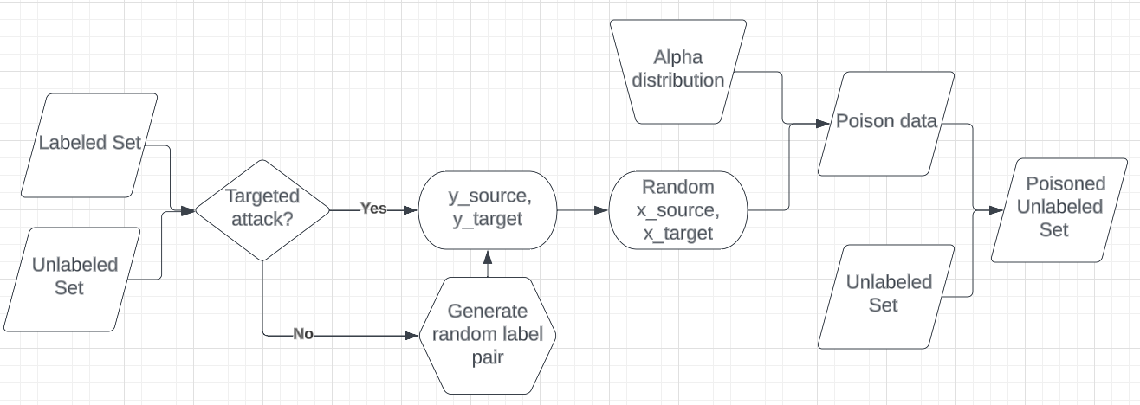
Implementation - Poisoner
Utilizing OOP, we create a class “Poisoner” that has all the functionalities needed for the interpolated consistency poisoning attack.
Transformations are applied after the poison samples are injected.
The overall flow of our implementation for an attack is below:

Slide 8
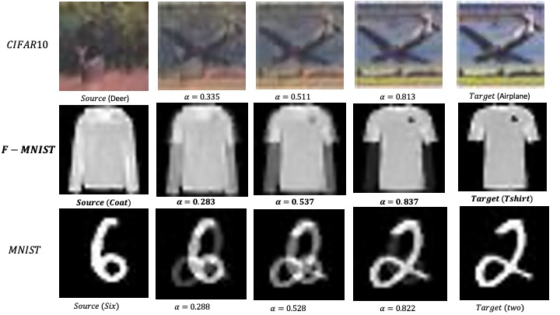
Implementation - Poisoner
Poison images are saved as PNG files.
Model training can be resumed by reloading the poison images.
Added “targeted attack” functionality.

Slide 9
Evaluation
Two Semi-Supervised Learning methods i.e MixMatch and FixMatch
(Pseudo-Labeling performs too bad)
Trained models with subset datasets for faster training
400 Labeled samples
29600 Unlabeled samples
300 poisoned samples (1%)
We used targeted attack - Fixed the source (labeled) and target (unlabeled) label pairs to evaluate for each dataset
The specific images for source and target were randomly sampled

Slide 10
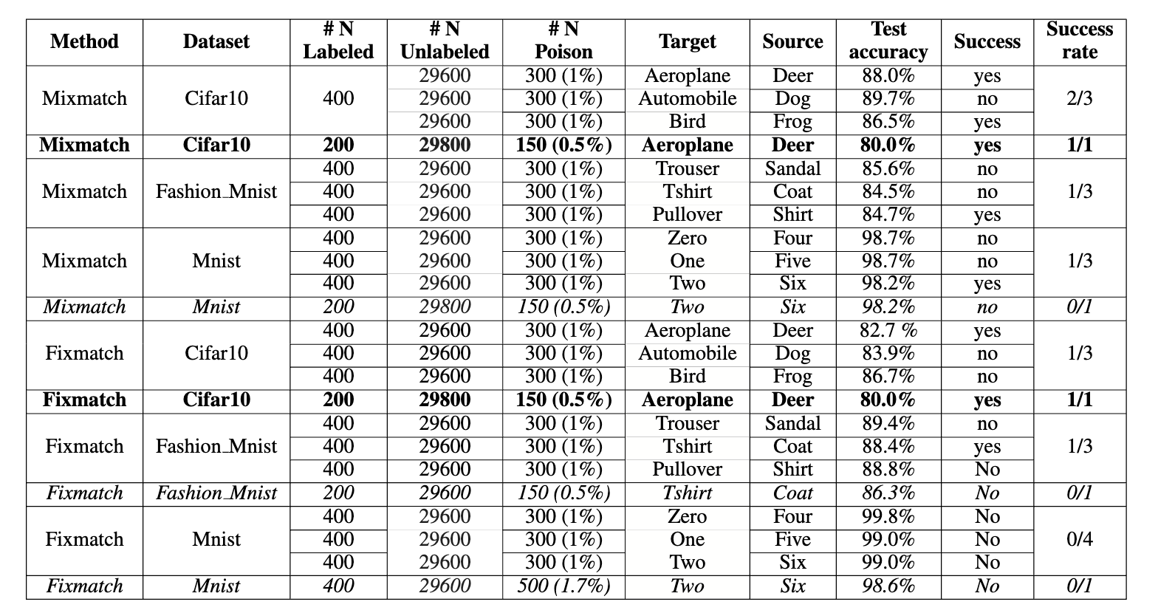
Results
Evaluated with 1% poisoned samples of the labeled and unlabeled dataset.
Some attacks succeeded with only 0.5% but no attack succeeded with 0.1% used by the paper.
Mixmatch is most vulnerable method compared to Fixmatch
At least 1 attack on each dataset succeeded on Mixmatch
Only 1 attack succeeded with Fixmatch on CIFAR10 and FashionMNIST
NONE of the tested attacks on MNIST fixmatch models succeeded.

Slide 11
Conclusion & Future Work
The proposed attack method in the paper indeed works and can be generalized to other datasets.
Future work building on this would be to evaluate the proposed defense methods on the datasets used in our work.
Exploring the performance of the attack using smaller poisoning ratios on the MNIST and Fashion MNIST datasets.

Slide 12
Challenges & Limitations
Training takes a lot more time than anticipated since:
FixMatch, MixMatch, and PseudoLabeling takes a lot of time to train due to the transformations needed to apply on the input images.
Using too small of a data subset resulted in bad models
No access to powerful hardware (even ColabPro is too weak)
Lack of documentations on the SSML methods used.
→ Took a lot of time to understand and modify unofficial implementations.

Slide 13
References
Carlini, N. 2021. Poisoning the unlabeled dataset of semi-supervised learning. arXiv preprint arXiv:2105.01622.
Sohn, Kihyuk, et al. "Fixmatch: Simplifying semi-supervised learning with consistency and confidence." Advances in neural information processing systems 33 (2020): 596-608.
Berthelot, D.; Carlini, N.; Goodfellow, I.; Papernot, N.; Oliver, A.; and Raffel, C. A. 2019. Mixmatch: A holistic approach to semi-supervised learning. Advances in neural information processing systems 32
Arazo, E.; Ortego, D.; Albert, P.; O’Connor, N. E.; and McGuinness, K. 2020. Pseudo-labeling and confirmation bias in deep semi-supervised learning. 2020 International Joint Conference on Neural Networks (IJCNN)

